Slide 1

Medical Report Generation
Members:
Nada Mohamed Mohamed Hassan
Hadeel Osama Abdullah Abbar
Nouran Sayed Nasr Ibrahim
Manar Mahmoud Ahmed
Hagar Ahmed Mahmoud
Supervised by:
Prof .Dr. Abeer Mahmoud
TA. Yomna Ahmed

Slide 2


INTRODUCTION
Medical imaging plays a significant role in the diagnosis and treatment of diseases.
Computer-aided diagnosis and medical imaging systems have improved in the past decade to a point where they can partially mimic radiologists.
The most common medical imaging application is the Chest X-Ray.

Slide 3
OBJECTIVE
Create an application that helps physicians to generate reports from medical images.
Insert chest x-ray as an input to the application, then generate a report automatically.

Slide 4
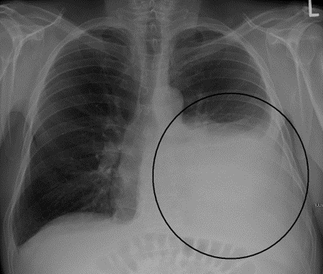
MOTIVATION
Building intelligence system that use recent deep learning model to generate reports.
Helps reduce workload of radiologists in writing medical reports.
We intend to effectively capture abnormal regions to describe normal and abnormal diagnoses.

Slide 5

System as Black Box
Visual Extractor
Encoder
Generated Report
Decoder
Relational Memory
Ground-truth: In comparison with study of there is again enlargement of the cardiac silhouette with a pacer device in place. No definite vascular congestion raising the possibility of underlying cardiomyopathy or pleural effusion. No acute focal pneumonia. The right picc line has been removed.

Slide 6
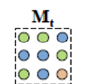
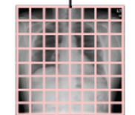
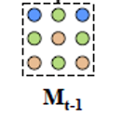
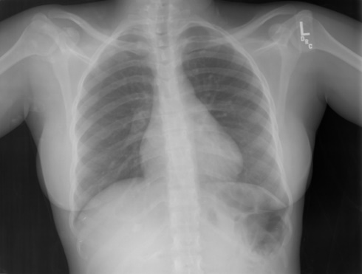
System Architecture
Output
Softmax
Linear
Decoder
Encoder layer
Memory-driven conditional layer
Feed Forward
Extend
Patch
features
Memory-driven conditional layer
Relational Memory
Multi-Head Attention
Visual extractor
Memory-driven conditional layer
Masked Multi-Head Attention
Output Embedding

Slide 7
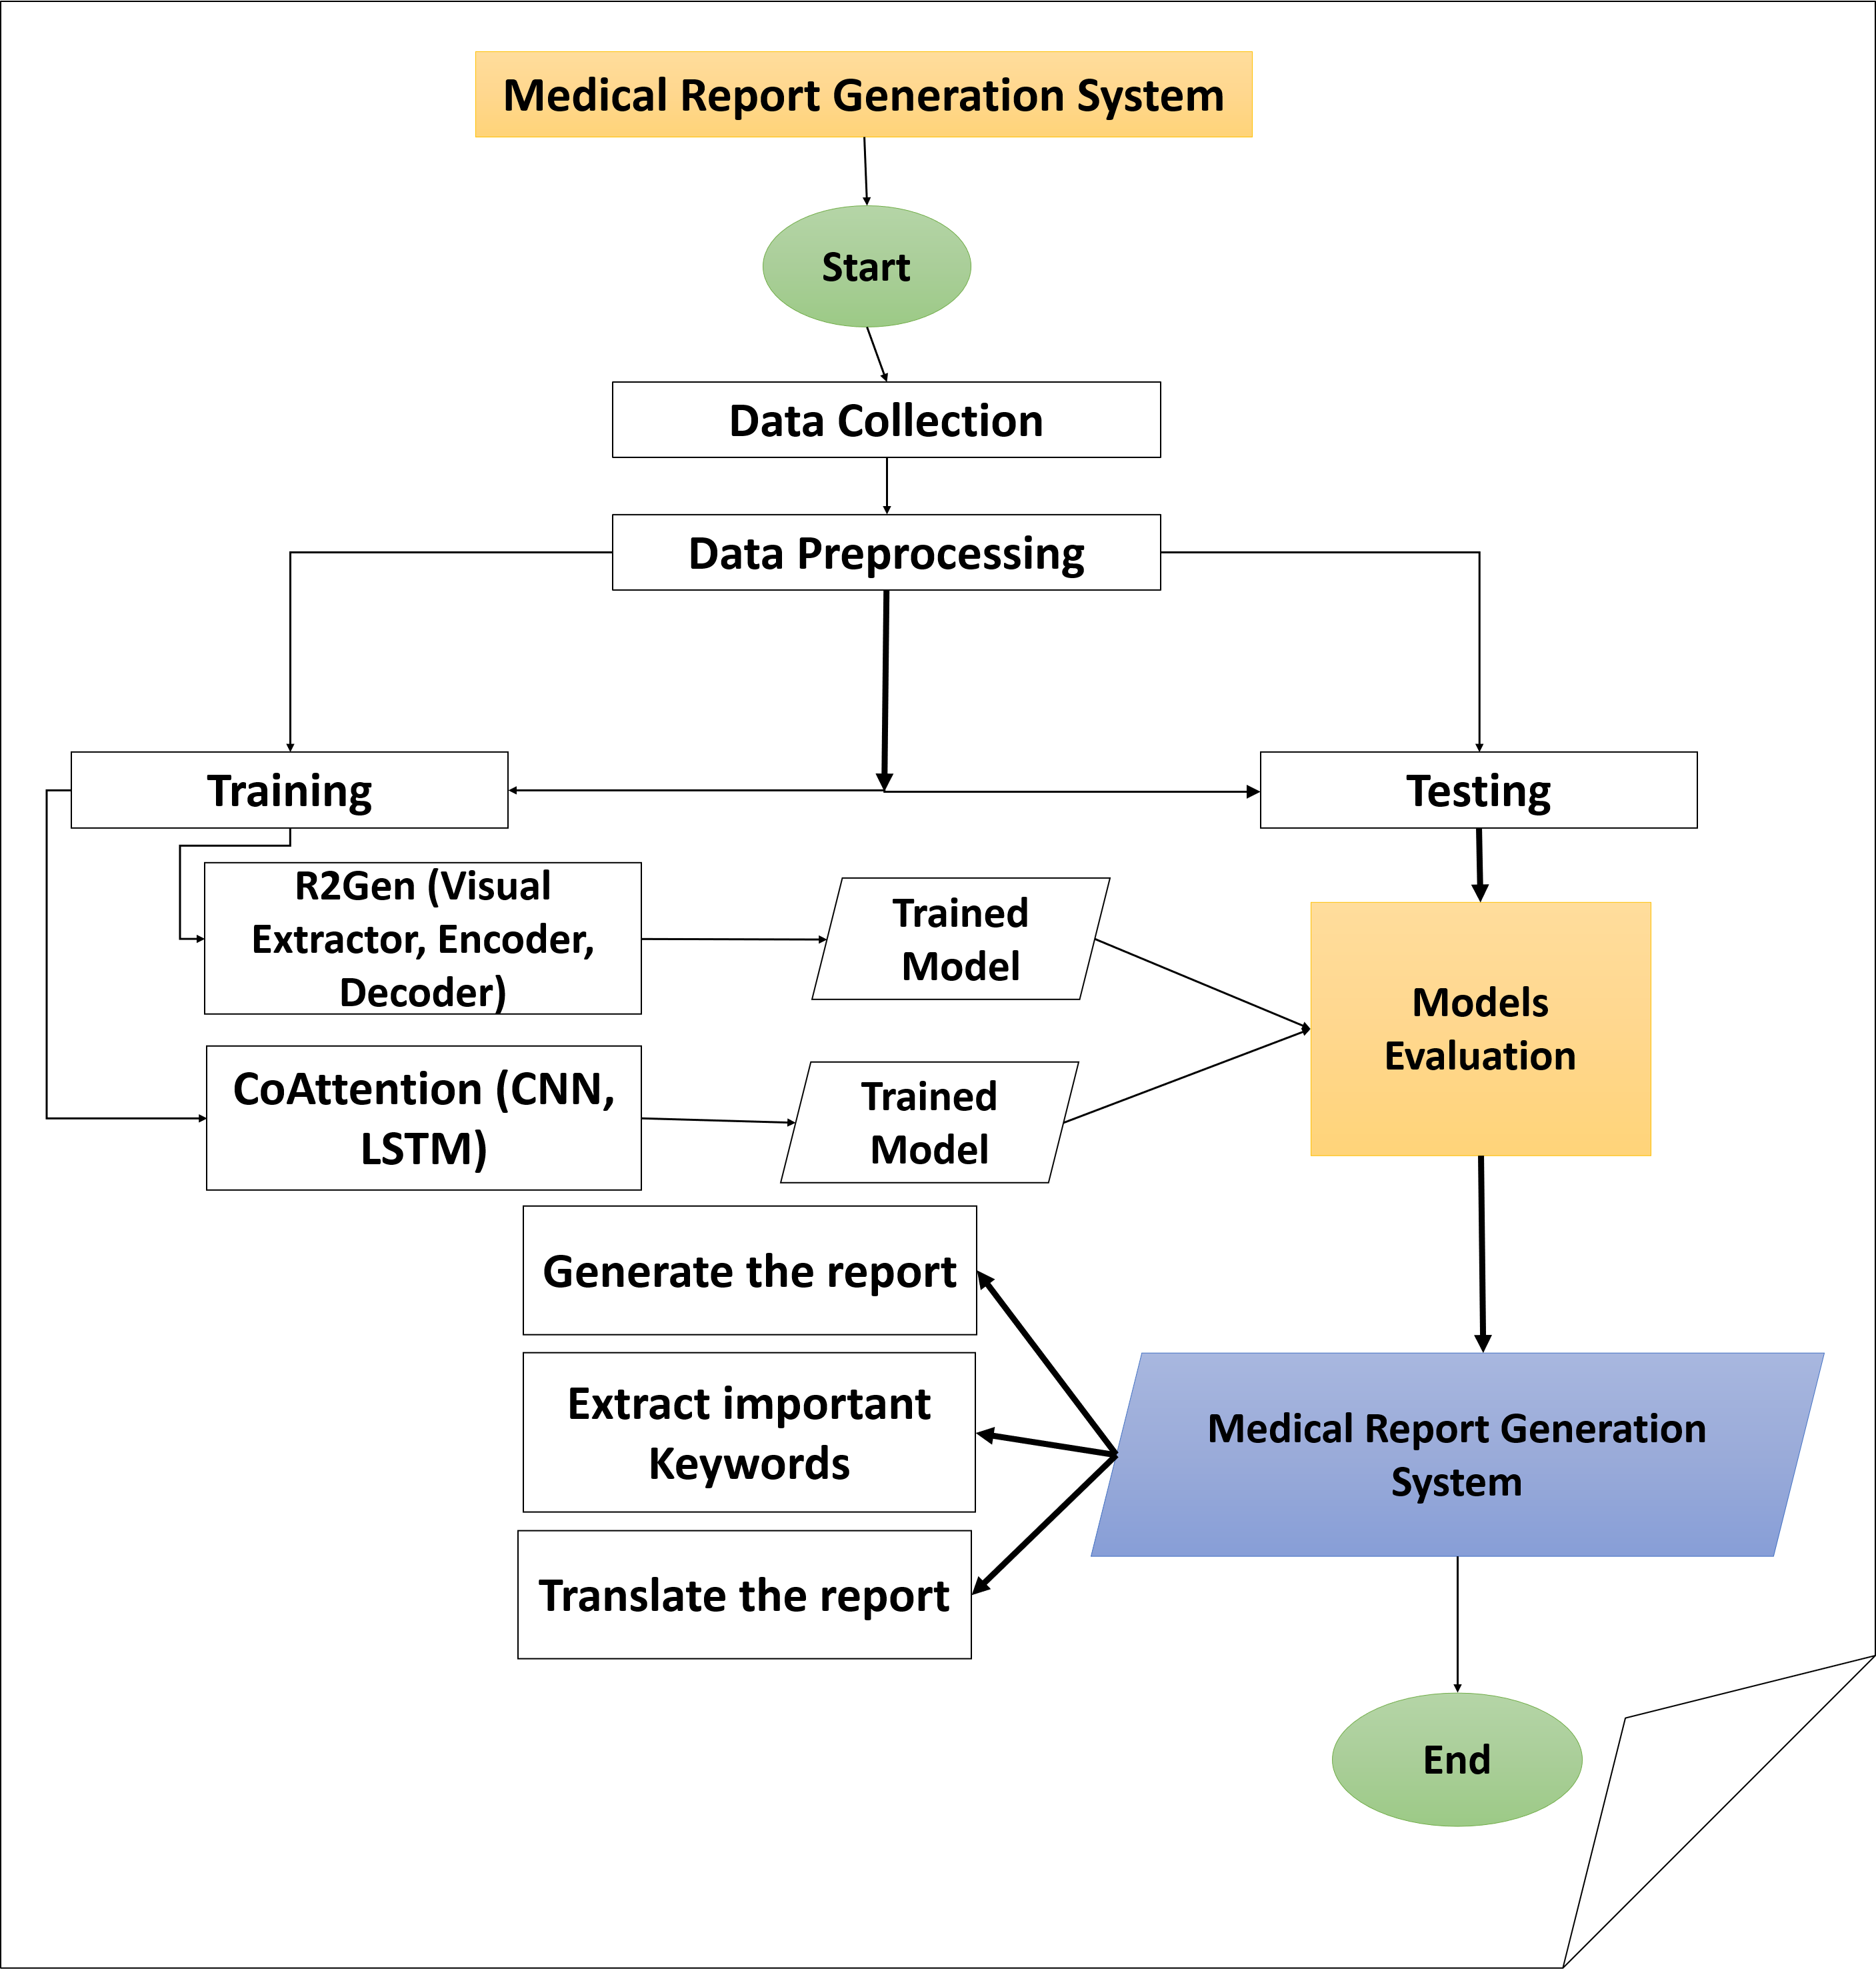
System Overview

Slide 8
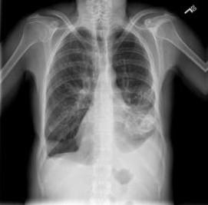
Dataset
IU-X-ray:
Public dataset contains 3,955 radiology reports and 7,470 X-rays images.
Report:
The heart is within normal limits in size. Surgical suture material projects over the right lung apex. The lungs are hyperlucent and hyperinflated compatible with emphysema. There is left lower lobe airspace disease identified. There is moderate left pleural effusion and small right pleural effusion. No visualized pneumothorax.

Slide 9
Explanation of finished phases
Train
Model trained on 5,226 images , 2,770 report with 100 epoch and batch size =16
Take an Image + report as input
Tokenize report and Load data (iu_xray)
Build model(R2Gen ):-
Visual Extractor using pretrained model resnet 101
transformer:- Encoder, Decoder
Relational memory
Memory-driven Conditional Layer Normalization (MCLN)
The model is trained under cross entropy loss with ADAM optimizer

Slide 10
Explanation of finished phases
TEST
Test with 1,496 Images, 790 report images.
create tokenizer and create data loader.
build model architecture.
handles of loss and metrics.
Result of belu-1: 0.44.

Slide 11
Experiments and Results
Other trials:
we wanted to reduce testing time for one image, so we used vgg19 at visual extractor.
Visual extractor | Blue-1 | Testing time for one image
Resnet101 | 0.44 | 12 sec
VGG19 | 0.43 | 11 sec

Slide 12

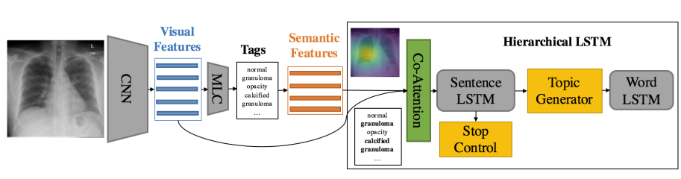
Other trials:
We try another deep learning Model(Co-Attention)
CNN
Tags
LSTM
Report
Co-Attention

Slide 13
BLEU-n:
BLEU (bilingual evaluation understudy) is an algorithm for evaluating the quality of text that is the correspondence between a machine's output and that of a human.
BLEU's output is always a number between 0 and 1.
BLEU compares the n-gram of the candidate translation with n-gram of the reference translation to count the number of matches.

Slide 14
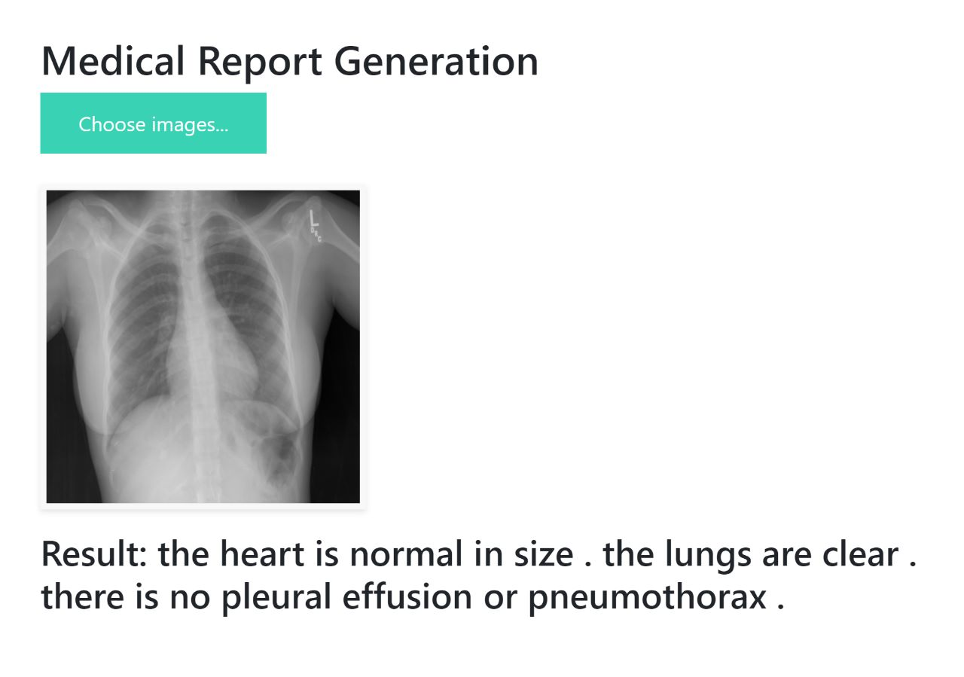
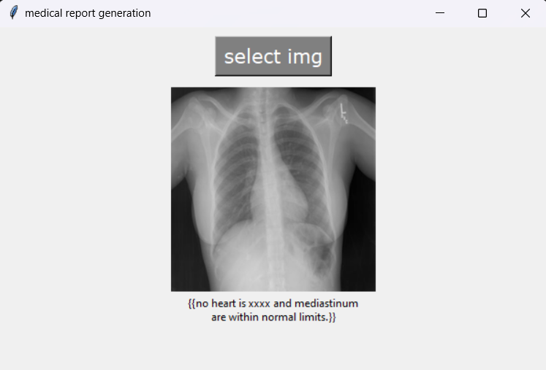
Experiments and Results
Model | Testing time for one image
R2Gen | 12 sec
CoAtt | 4 sec

Slide 15
Explanation of finished phases
For R2gen,
website using Flask :
Upload 2 images, then report generated.
Deployment
For CoAtt,
Desktop app using Tkinter GUI & pyinstaller :
Upload 1 image, then report generated.

Slide 16
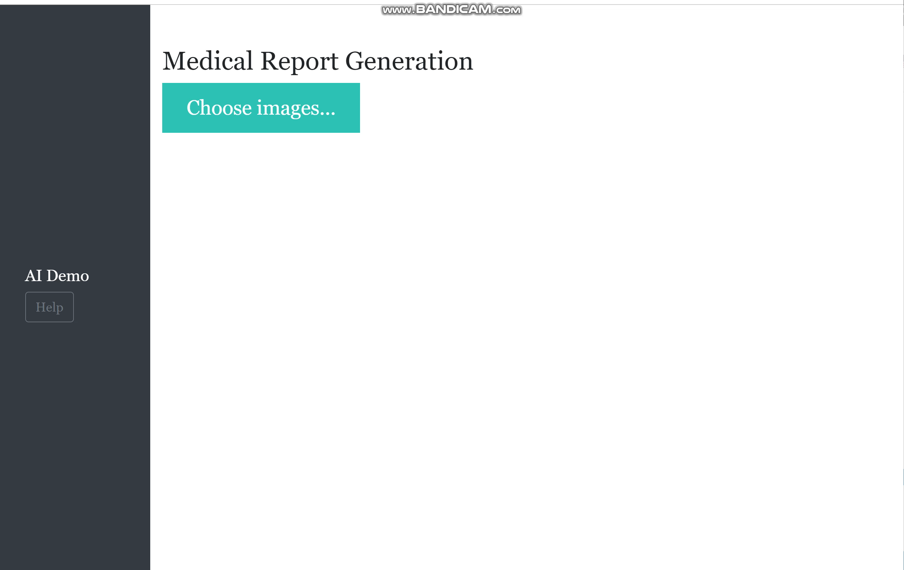
Demo

Slide 17
What’s Next?
By using output report ,make standard report
Improve UI.

Slide 18
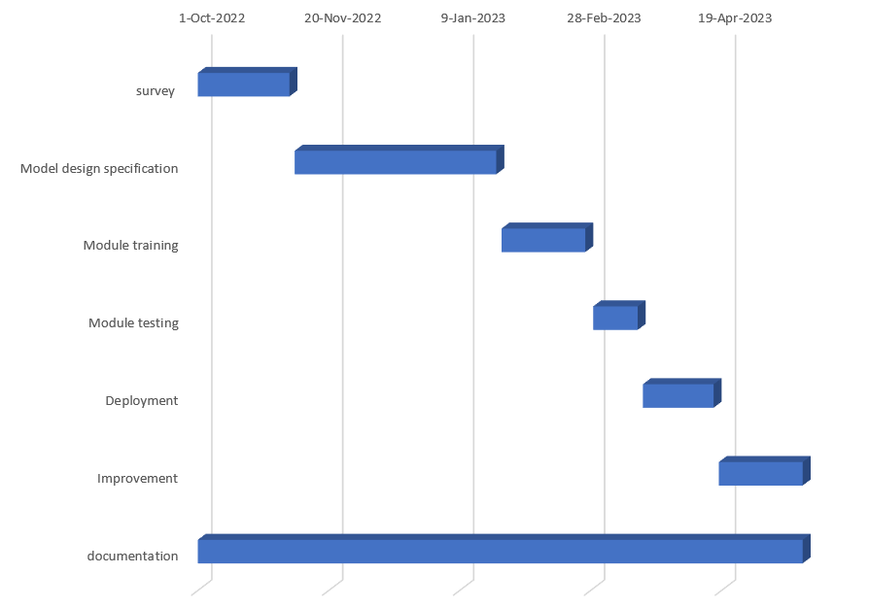
Time Plan

Slide 19
References
Salman Khan, Muzammal Naseer, Munawar Hayat, Syed Waqas Zamir,Fahad Shahbaz Khan, and Mubarak Shah
Chen, Z., Song, Y., Chang, T.H. and Wan, X., 2020. Generating radiology reports via memory-driven transformer. arXiv preprint arXiv:2010.16056.
Sai, Rahul & Kather, Sharmila & Tripathy, B.K.. (2021). Automated Medical Report Generation on Chest X-Ray Images using Co-Attention mechanism.10.13140/RG.2.2.26061.15843.
Vaswani, A., Shazeer, N., Parmar, N., Uszkoreit, J., Jones, L., Gomez, A.N., Kaiser, Ł. and Polosukhin, I., 2017. Attention is all you need. Advances in neural information processing systems, 30.

Slide 20


THANK YOU

Slide 21
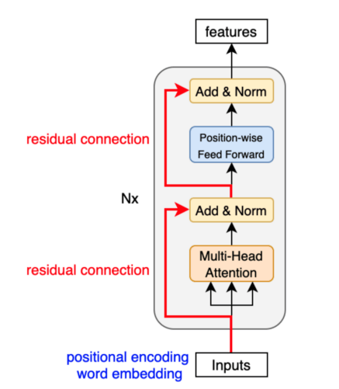
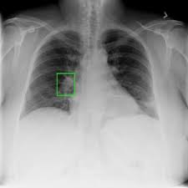
Encoder
Standard encoder from transformer
Input: features extracted by visual extractor.
Output: Hidden states encoded from input features.
Consists of two main parts
Multi-head Attention.
Feed Forward layer.

Slide 22
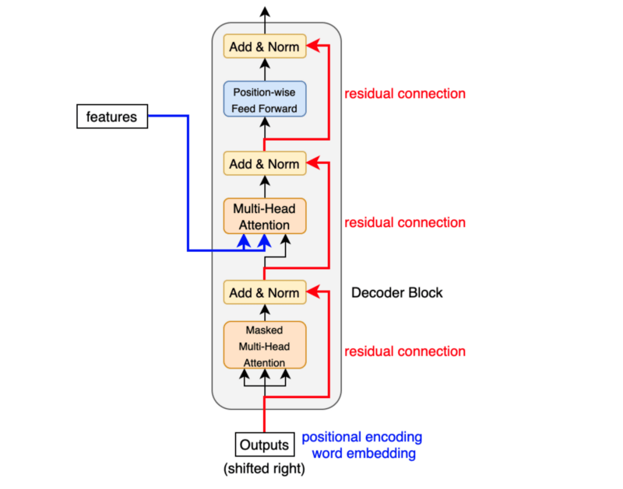
Decoder
Standard decoder from transformer
Input: previous output from decoder, hidden features extracted from encoder.
Output: subsequent input to the decoder.
Consists of three main parts
Masked Multi-head Attention.
Multi-head Attention.
Positional-wise Feed Forward layer.

Slide 23
Related Work
Paper Name | Methods | Year | Dataset | Performance (BL-1)
Automated Medical Report Generation on Chest X-Ray Images | CNN Hierarchical LSTMs Co-Attention mechanism | 2021 | CXR (chest X-ray) | 0.213
CoAttention | CNN MLC Co-Attention. LSTM | 2018 | UI X-Ray PEIR Gross | IU X-Ray: 0.517 | PEIR Gross: 0.300

Slide 24
Related Work
Paper Name | Methods | Year | Dataset | Performance (BL-1)
Contrastive Attention (CA) | CNN. Aggregate Attention, Differentiate Attention. Hierarchical LSTM | 2021 | IU-X-ray MIMIC-CXR | IU-X-ray: 0.452 | MIMIC-CXR: 0.350
R2gen | Visual extractor(CNN) Encoder (transformer) Decoder (RM-MCLN) | 2020 | IU X-Ray MIMIC-CXR | IU X-Ray: 0.470 | MIMIC-CXR: 0.353

